Slide 1
Query-By-Example Spoken Term Detection Using Phonetic Posteriorgram Templates
Haibing Cao

Slide 2
Content
Introduction
Query-By-Example using posteriorgram
Experiments
Conclusions

Slide 3
Introduction
LVCSR approach is commonly used and shows good performance for well-resourced tasks.

Slide 4
Introduction
LVCSR approach is commonly used and shows good performance for well-resourced tasks.
What if the available training data is severely limited?

Slide 5
Introduction
LVCSR approach is commonly used and shows good performance for well-resourced tasks.
What if the available training data is severely limited?
Template Matching (Dynamic Time Warping)

Slide 6
Introduction
LVCSR approach is commonly used and shows good performance for well-resourced tasks.
What if the available training data is severely limited?
Template Matching (Dynamic Time Warping)
Y_{j} ： feature of the j_{th} frame of the utterance to recognize
Y₁ Y₂ Y₃ Y₄ Y₅ Y₆ Y₇ Y₈ Y₉ Y₁₀

Slide 7
Introduction
LVCSR approach is commonly used and shows good performance for well-resourced tasks.
What if the available training data is severely limited?
Template Matching (Dynamic Time Warping)
X_{i}^{j} ：feature of the j_{th} frame of the i_{th} word
Y_{j} ： feature of the j_{th} frame of the utterance to recognize
X₁¹ X₁² X₁³ X₁⁴ X₂¹ X₂² X₂³ X₃¹ X₃² X₃³ X₃⁴ X₃⁵
Y₁ Y₂ Y₃ Y₄ Y₅ Y₆ Y₇ Y₈ Y₉ Y₁₀

Slide 8
Introduction
LVCSR approach is commonly used and shows good performance for well-resourced tasks.
What if the available training data is severely limited?
Template Matching (Dynamic Time Warping)
Y₁₀
Y₉
Y₈
Y₇
Y₆
Y₅
Y₄
Y₃
Y₂
Y₁
X₁¹ X₁² X₁³ X₁⁴ X₂¹ X₂² X₂³ X₃¹ X₃² X₃³ X₃⁴ X₃⁵
X_{i}^{j} ：feature of the j_{th} frame of the i_{th} word
Y_{i} ： feature of the j_{th} frame of the utterance to recognize

Slide 9
Query-By-Example using posteriorgram
feature of query
phonetic recognizer
posteriorgram of query
similarity matrix
DTW
ranked list
feature of test utterance
posteriorgram of test utterance

Slide 10
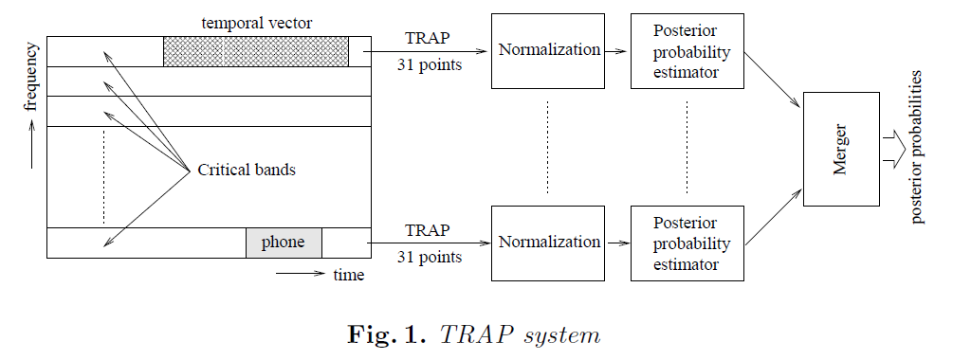
Query-By-Example using posteriorgram
feature of query
phonetic recognizer
posteriorgram of query
similarity matrix
DTW
ranked list
feature of test utterance
posteriorgram of test utterance

Slide 11
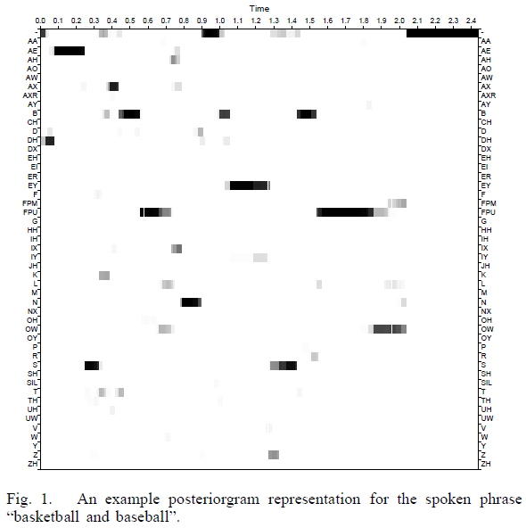
Query-By-Example using posteriorgram
feature of query
phonetic recognizer
posteriorgram of query
similarity matrix
DTW
ranked list
feature of test utterance
posteriorgram of test utterance

Slide 12
Query-By-Example using posteriorgram
feature of query
phonetic recognizer
posteriorgram of query
similarity matrix
DTW
ranked list
feature of test utterance
posteriorgram of test utterance
Distance between and :
Smoothing:

Slide 13
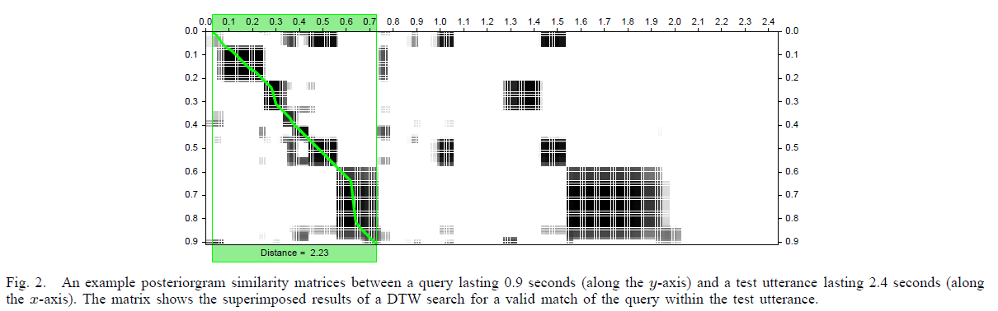
Query-By-Example using posteriorgram
feature of query
phonetic recognizer
posteriorgram of query
similarity matrix
DTW
ranked list
feature of test utterance
posteriorgram of test utterance

Slide 14
Query-By-Example using posteriorgram
feature of query
phonetic recognizer
posteriorgram of query
similarity matrix
DTW
ranked list
feature of test utterance
posteriorgram of test utterance
two constraints for dynamic time warping (DTW)
accumulate similarity scores along path extensions
constrain path extension

Slide 15
Query-By-Example using posteriorgram
feature of query
phonetic recognizer
posteriorgram of query
similarity matrix
DTW
ranked list
feature of test utterance
posteriorgram of test utterance
two constraints for dynamic time warping (DTW)
accumulate similarity scores along path extensions
constrain path extension
(i,j)
(1)extend the path to i+n and j+m (n=1 or m=1);

Slide 16
Query-By-Example using posteriorgram
feature of query
phonetic recognizer
posteriorgram of query
similarity matrix
DTW
ranked list
feature of test utterance
posteriorgram of test utterance
two constraints for dynamic time warping (DTW)
accumulate similarity scores along path extensions
constrain path extension
(i,j)
 |  |  | ···
 | ··
(1)extend the path to i+n and j+m (n=1 or m=1);

Slide 17
Query-By-Example using posteriorgram
feature of query
phonetic recognizer
posteriorgram of query
similarity matrix
DTW
ranked list
feature of test utterance
posteriorgram of test utterance
two constraints for dynamic time warping (DTW)
accumulate similarity scores along path extensions
constrain path extension
(i,j)
 |  |  | ···
 | ··
(1)extend the path to i+n and j+m (n=1 or m=1);
(2)score for path extension:
m=1
n=1

Slide 18
Experiments
Data Set
training data: 10 hours of English data from the Switchboard cellular corpus
evaluation data: 36 conversations in Fisher English development test set from NIST Spoken Term Detection Evaluation 2006
query terms: 40 words that have occurrence counts within the evaluation set of between 11 to 42

Slide 19
Experiments
Evaluation Metrics
P@10
P@N
EER (average detection equal error rate)

Slide 20
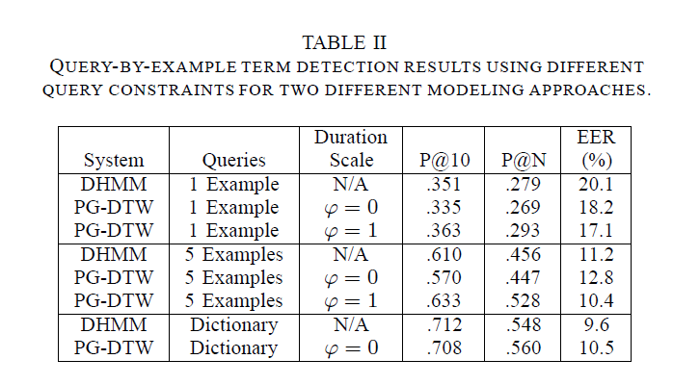
Experiments
Results

Slide 21
Experiments
Results
word₁: ph₁ ph₂ ph₃ ph₄
i_{th} phoneme’s location

Slide 22
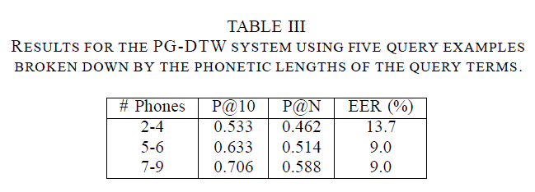
Experiments
Results

Slide 23
Conclusions
an effective query-by-example approach for low-resource language;
further improvements got by: combining multiple query templates, merging the similar sequential frames into a single multi-frame segment;

Slide 24
Conclusions
an effective query-by-example approach for low-resource language;
further improvements got by: combining multiple query templates, merging the similar sequential frames into a single multi-frame segment;
Thank you

